Slide 1
Chapter 20
How to use Entity Framework Core

Slide 2
Objectives (part 1)
Applied
Create an Entity Data Model from an existing database.
Use LINQ to Entities to retrieve data from one or more database tables.
Use EF Core to add, modify, and delete rows in a database table.
Bind controls to an entity collection or the results of a query.
Knowledge
Explain how EF Core works.
Describe these terms as they relate to an Entity Data Model: conceptual model, storage model, mappings, object context, entity class, navigation property, and association.
Describe how to add EF packages to a project.

Slide 3
Objectives (part 2)
Distinguish between Code First development and Database First development.
Describe a concurrency conflict and distinguish between these two types of concurrency control: last-in wins and optimistic.

Slide 4
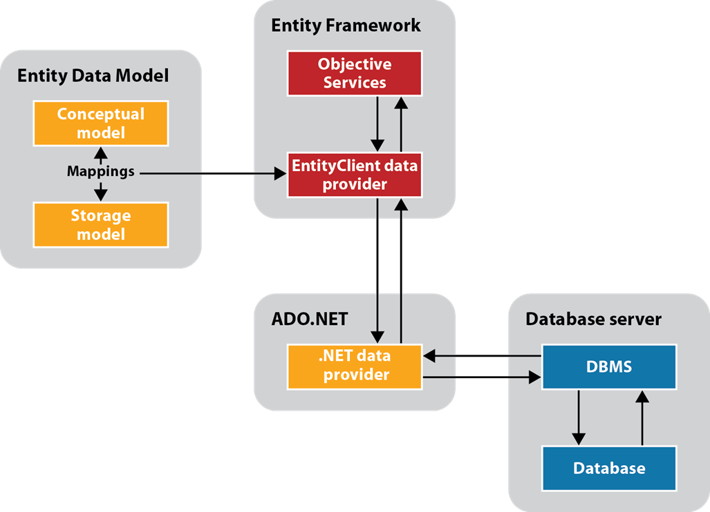
How Entity Framework Core works

Slide 5
Entity Framework concepts
Entity Framework (EF) Core provides a layer between the database for an application and the objects for an application. The purpose of this layer is to provide an interface that allows the data in the database to be presented to the application as objects.
To provide the interface between objects and database, the Entity Framework uses an Entity Data Model that defines a conceptual model, a storage model, and mappings between the two models.
When you execute a query against a conceptual model, Object Services works with the EntityClient data provider and the Entity Data Model to translate the query into one that can be executed by the database. When the results are returned from the database, Object Services translates them back to the objects defined by the conceptual model.
The Entity Framework also provides for tracking changes and for submitting those changes to the database.

Slide 6
Three ways to query a conceptual model
LINQ to Entities
Entity SQL
Query builder methods

Slide 7
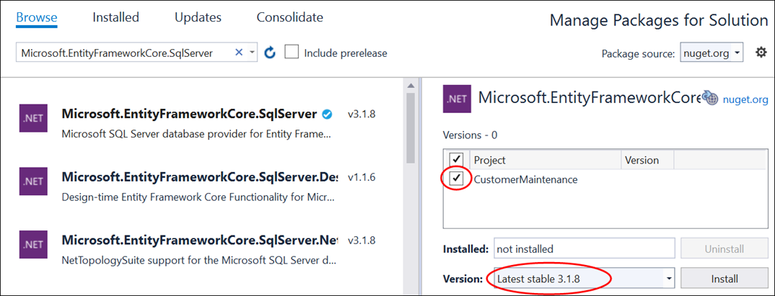
How to open the NuGet Package Manager
Select Tools→NuGet Package Manager→Manage NuGet Packages for Solution.
The NuGet Package Manager with the EF Core package selected

Slide 8
How to install the EF Core packages
Click on the Browse link in the upper left corner.
Type “Microsoft.EntityFrameworkCore.SqlServer” in the search box.
Click on the appropriate package from the list that appears in the left-hand panel.
In the right-hand panel, check the project name, select the version that matches the version of .NET Core you’re running, and click Install.
Review the License Acceptance dialog that comes up and click I Accept.
Type “Microsoft.EntityFrameworkCore.Tools” in the search box.
Repeat steps 3 through 5.
Optionally, type “Microsoft.EntityFrameworkCore.Proxies” in the search box and repeat steps 3 through 5.

Slide 9
Parameters for the Scaffold-DbContext command
-Connection
-Provider
-OutputDir
-Context
-DataAnnotations
-UseDatabaseNames
-Force
Common values used in a connection string for SQL Server Express LocalDB
Data Source/Server
AttachDbFilename
Integrated Security

Slide 10
A Scaffold-DbContext command for a Sql Server Express LocalDB database
PM> Scaffold-DbContext –Connection
"Data Source=(LocalDB)\MSSQLLocalDB; AttachDBFilename=C:\C#\Database\MMABooks.mdf;
Integrated security=True" -Provider Microsoft.EntityFrameworkCore.SqlServer
-OutputDir Models\DataLayer -Context MMABooksContext
-DataAnnotations –Force
The same command with the flags for the required parameters omitted
PM> Scaffold-DbContext
"Data Source=(LocalDB)\MSSQLLocalDB; AttachDBFilename=C:\C#\Database\MMABooks.mdf;
Integrated security=True"
Microsoft.EntityFrameworkCore.SqlServer
-OutputDir Models\DataLayer -Context MMABooksContext
-DataAnnotations –Force

Slide 11
Database First development concepts
With Database First development, you generate database (DB) context and entity classes from an existing database. To do that, you can use the Scaffold-DbContext command.
The DB context class is used to communicate with the database, and the entity classes represent the objects used by the application.
You enter the Scaffold-DbContext command in the NuGet Package Manager Console (PMC) window. To display this window from Visual Studio, select Tools→NuGet Package Manager→Package Manager Console.

Slide 12
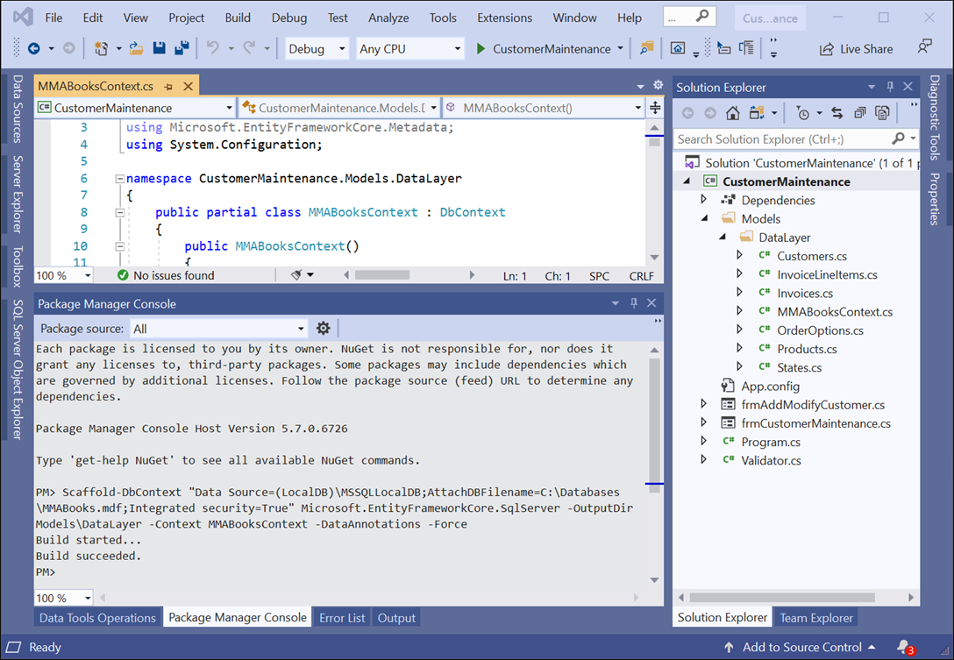
A Visual Studio project with an Entity Data Model

Slide 13
Two methods of the DbContext class
OnConfiguring(DbContextOptionsBuilder)
OnModelCreating(ModelBuilder)

Slide 14
The DB context class generated by the Scaffold-DbContext command (part 1)
using Microsoft.EntityFrameworkCore;
namespace CustomerMaintenance.Models.DataLayer
{
public partial class MMABooksContext : DbContext
{
public MMABooksContext() {}
public MMABooksContext(DbContextOptions<MMABooksContext> options)
: base(options) {}
public virtual DbSet<Customers> Customers { get; set; }
public virtual DbSet<InvoiceLineItems> InvoiceLineItems { get; set; }
public virtual DbSet<Invoices> Invoices { get; set; }
public virtual DbSet<OrderOptions> OrderOptions { get; set; }
public virtual DbSet<Products> Products { get; set; }
public virtual DbSet<States> States { get; set; }

Slide 15
The DB context class generated by the Scaffold-DbContext command (part 2)
protected override void OnConfiguring(
DbContextOptionsBuilder optionsBuilder)
{
if (!optionsBuilder.IsConfigured)
{
optionsBuilder.UseSqlServer(
"Data Source=(LocalDB)\\MSSQLLocalDB;
AttachDBFilename=C:\\C#\\Database\\MMABooks.mdf;
Integrated Security=True");
}
}
protected override void OnModelCreating(ModelBuilder modelBuilder)
{
modelBuilder.Entity<Customers>(entity => {
entity.Property(e => e.Address).IsUnicode(false);
entity.Property(e => e.City).IsUnicode(false);
entity.Property(e => e.Name).IsUnicode(false);
entity.Property(e => e.State)
.IsUnicode(false)
.IsFixedLength();
entity.Property(e => e.ZipCode)
.IsUnicode(false)
.IsFixedLength();

Slide 16
The DB context class generated by the Scaffold-DbContext command (part 3)
entity.HasOne(d => d.StateNavigation)
.WithMany(p => p.Customers)
.HasForeignKey(d => d.State)
.OnDelete(DeleteBehavior.ClientSetNull)
.HasConstraintName("FK_Customers_States");
});
modelBuilder.Entity<InvoiceLineItems>(entity =>
{
entity.HasKey(e => new { e.InvoiceId, e.ProductCode });
entity.Property(e => e.ProductCode)
.IsUnicode(false)
.IsFixedLength();
entity.HasOne(d => d.Invoice)
.WithMany(p => p.InvoiceLineItems)
.HasForeignKey(d => d.InvoiceId)
.HasConstraintName("FK_InvoiceLineItems_Invoices");
entity.HasOne(d => d.ProductCodeNavigation)
.WithMany(p => p.InvoiceLineItems)
.HasForeignKey(d => d.ProductCode)
.OnDelete(DeleteBehavior.ClientSetNull)
.HasConstraintName("FK_InvoiceLineItems_Products");
});

Slide 17
The DB context class generated by the Scaffold-DbContext command (part 4)
modelBuilder.Entity<Invoices>(entity =>
{
entity.HasOne(d => d.Customer)
.WithMany(p => p.Invoices)
.HasForeignKey(d => d.CustomerId)
.HasConstraintName("FK_Invoices_Customers");
});
modelBuilder.Entity<Products>(entity =>
{
entity.Property(e => e.ProductCode)
.IsUnicode(false)
.IsFixedLength();
entity.Property(e => e.Description).IsUnicode(false);
});
modelBuilder.Entity<States>(entity =>
{
entity.Property(e => e.StateCode)
.IsUnicode(false)
.IsFixedLength();
entity.Property(e => e.StateName).IsUnicode(false);
});
OnModelCreatingPartial(modelBuilder);
}
partial void OnModelCreatingPartial(ModelBuilder modelBuilder);
}
}

Slide 18
Some of the data annotation attributes for configuration
Attribute Description
Key The database column that’s the primary key.
Column The name of the column in the database if it’s different from the property name.
Required Specifies that the property’s value is required.
StringLength Specifies the maximum string length allowed by the database column.
ForeignKey Specifies the property that’s used as a foreign key in a relationship.
InverseProperty Specifies the navigation property on the other end of a relationship.

Slide 19
The generated Customers partial class (part 1)
using System.Collections.Generic;
using System.ComponentModel.DataAnnotations;
using System.ComponentModel.DataAnnotations.Schema;
namespace CustomerMaintenance.Model.DataLayer {
public partial class Customers {
public Customers() {
Invoices = new HashSet<Invoices>();
}
[Key]
[Column("CustomerID")]
public int CustomerId { get; set; }
[Required]
[StringLength(100)]
public string Name { get; set; }
[Required]
[StringLength(50)]
public string Address { get; set; }

Slide 20
The generated Customers partial class (part 2)
// City, State, and ZipCode properties go here
[ForeignKey(nameof(State))]
[InverseProperty(nameof(States.Customers))]
public virtual States StateNavigation { get; set; }
[InverseProperty("Customer")]
public virtual ICollection<Invoices> Invoices { get; set; }
}
}

Slide 21
An App.config file that includes a database connection string
<?xml version="1.0" encoding="utf-8" ?>
<configuration>
<connectionStrings>
<add name="MMABooks"
connectionString=
"Data Source=(LocalDB)\MSSQLLocalDB;
AttachDBFilename=C:\C#\Database\MMABooks.mdf;
Integrated Security=True"/>
</connectionStrings>
</configuration>

Slide 22
The updated OnConfiguring() method in the DB context file
protected override void OnConfiguring(
DbContextOptionsBuilder optionsBuilder) {
if (!optionsBuilder.IsConfigured) {
optionsBuilder.UseSqlServer(
ConfigurationManager
.ConnectionStrings["MMABooks"]
.ConnectionString);
}
}

Slide 23
A partial class that adds a read-only property
namespace CustomerMaintenance.Models.DataLayer
public partial class Customers
{
public bool HasAddress =>
!string.IsNullOrEmpty(Address);
}
}

Slide 24
A statement that creates an instance of the DB context
MMABooksContext context = new MMABooksContext();
A query that stores all the invoices in a variable
var invoices = context.Invoices.ToList();
A query that gets a single invoice by ID
var selectedInvoice = context.Invoices
.Where(i => i.InvoiceId == 33).FirstOrDefault();
Another way to get a single invoice by ID
var selectedInvoice = context.Invoices.Find(33);

Slide 25
A query that gets selected invoices
var invoices = context.Invoices
.Where(i => i.InvoiceTotal > 250)
.Select(i => new { i.CustomerId,
i.InvoiceDate,
i.InvoiceTotal })
.ToList();
A query that joins customer and invoice data
var customerInvoices = context.Customers
.Join(context.Invoices,
c => c.CustomerId,
i => i.CustomerId,
(c, i) => new { c.Name, i.InvoiceDate,
i.InvoiceTotal })
.OrderBy(ci => ci.Name)
.ThenByDescending(ci => ci.InvoiceTotal).ToList();

Slide 26
A query that uses eager loading to load related entities
var selectedCustomer =
context.Customers.Include("Invoices")
.Where(c => c.CustomerId == customerID).Single();

Slide 27
Code that explicitly loads the entities on the many side of a relationship
var selectedCustomer = context.Customers
.Where (c => c.CustomerId == customerID).Single();
if (! context.Entry(selectedCustomer)
.Collection("Invoices").IsLoaded)
context.Entry(selectedCustomer)
.Collection("Invoices").Load();

Slide 28
Code that explicitly loads the entity on the one side of a relationship
var selectedInvoice = context.Invoices
.Where(i => i.InvoiceId == invoiceID).Single();
if (! context.Entry(selectedInvoice)
.Reference("Customer").IsLoaded)
context.Entry(selectedInvoice)
.Reference("Customer").Load();

Slide 29
A query that uses lazy loading to load related entities
var customerInvoices = context.Customers
.Where(c => c.CustomerId == customerID)
.Select(c => new { c.Name, c.Invoices }).Single();

Slide 30
The NuGet package needed to enable lazy loading
Microsoft.EntityFrameworkCore.Proxies
A DB context file configured to enable lazy loading
protected override void OnConfiguring(
DbContextOptionsBuilder optionsBuilder)
{
if (!optionsBuilder.IsConfigured) {
optionsBuilder
.UseSqlServer(...)
.UseLazyLoadingProxies();
}
}

Slide 31
The Customers entity generated by the Scaffold-DbContext command
public partial class Customers // public, unsealed entity
{
public Customers() // public constructor
{
Invoices = new HashSet<Invoices>();
}
...
// virtual navigation properties
[ForeignKey(nameof(State))]
[InverseProperty(nameof(States.Customers))]
public virtual States StateNavigation { get; set; }
[InverseProperty("Customer")]
public virtual ICollection<Invoices> Invoices { get; set; }
}

Slide 32
How to enable lazy loading
Install the EntityFrameworkCore.Proxies NuGet package.
In the OnConfiguring() method of the DB context file, call the UseLazyLoadingProxies() method.
Make sure each entity class is public and unsealed, has a public or protected constructor, and has navigation properties that are virtual.

Slide 33
Three of the methods of the DbSet class
Add(entity)
Update(entity)
Remove(entity)
Code that adds a new entity
var customer = new Customers {
Name="Nick Taggart", Address="123 Main St",
City="Fresno", State="CA", ZipCode="93650" };
context.Customers.Add(customer);
Code that modifies an existing entity
var customer = context.Customers.Find(1);
customer.ZipCode = "93651";
context.Customers.Update(customer); // usually not needed
Code that marks an entity for deletion
var customer = context.Customers.Find(1);
context.Customers.Remove(customer);

Slide 34
One of the methods of the DbContext class
SaveChanges()
A statement that saves the changes to the database
int rowsAffected = context.SaveChanges();

Slide 35
Code that handles database exceptions (part 1)
private void btnDelete_Click(object sender, EventArgs e)
{
DialogResult result =
MessageBox.Show("Delete " + selectedCustomer.Name + "?",
"Confirm Delete", MessageBoxButtons.YesNo,
MessageBoxIcon.Question);
if (result == DialogResult.Yes)
{
try {
context.Customers.Remove(selectedCustomer);
context.SaveChanges(true);
this.ClearControls();
}
catch (DbUpdateException ex) {
string errorMessage = "";
var sqlException = (SqlException)ex.InnerException;
foreach (SqlError error in sqlException.Errors)
{
errorMessage += "ERROR CODE: " + error.Number +
" " + error.Message + "\n";
}
MessageBox.Show(errorMessage);
}

Slide 36
Code that handles database exceptions (part 2)
catch (Exception ex)
{
MessageBox.Show(ex.Message, ex.GetType().ToString());
}
}
}
A using directive for the SQL Server data provider
using Microsoft.Data.SqlClient;

Slide 37
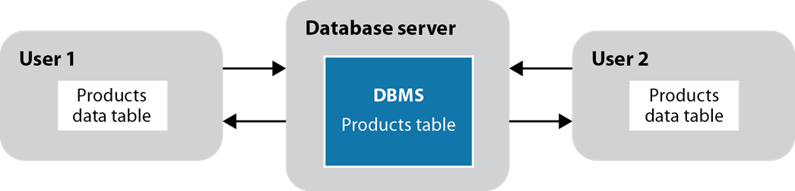
Two users who are working with copies of the same data

Slide 38
Concurrency concepts (part 1)
When two or more users retrieve the data in the same row of a database table at the same time, it is called a concurrency conflict. Because EF Core uses a disconnected data architecture, the database management system can’t prevent this from happening.
If two users try to update the same row in a database table at the same time, the second user’s changes could overwrite the changes made by the first user. Whether or not that happens, though, depends on the concurrency control that the programs use.
By default, EF Core uses last in wins. This means that the program doesn’t check whether a row has been changed before an update or delete operation takes place. Instead, the operation proceeds without throwing an exception. This can lead to errors in the database.

Slide 39
Concurrency concepts (part 2)
With optimistic concurrency, the program checks whether the database row that’s going to be updated or deleted has been changed since it was retrieved. If it has, a concurrency exception occurs and the update or delete operation is refused. Then, the calling program should handle the exception.

Slide 40
How to avoid concurrency conflicts
For many applications, concurrency conflicts rarely occur. As a result, optimistic concurrency is adequate.
If concurrency conflicts are likely to be a problem, a program can be designed so it updates the database and refreshes the entity collections frequently. That way, concurrency errors are less likely to occur.
Another way to avoid concurrency conflicts is to design a program so it retrieves and updates just one row at a time. That way, there’s less chance that two users will retrieve and update the same row at the same time.
A program can also use pessimistic concurrency, which assumes that concurrency conflicts will happen and avoids them by locking a database record while it’s being updated. Since locking database records creates its own problems, most applications don’t use pessimistic concurrency.

Slide 41
How to configure a concurrency token with attributes
public class Customers {
public int CustomerId { get; set; }
public string Name {get; set; }
[ConcurrencyCheck]
public string Address {get; set; }
.
.
}

Slide 42
How to configure a rowversion property with attributes
public class Customers {
public int CustomerId { get; set; }
public string Name {get; set; }
public string Address {get; set; }
.
.
[Timestamp]
public byte[] RowVersion { get; set; }
}

Slide 43
How to simulate a concurrency conflict
// get a customer from the database
var c = context.Customers.Find(1);
// change address in the database
context.Database.ExecuteSqlRaw(
"UPDATE Customers " +
"SET Address = '1 Main St' " +
"WHERE CustomerId = 1");
// change address in the entity
c.Address = "26 Duffie Drive";
context.SaveChanges();

Slide 44
A method that handles a concurrency exception (part 1)
private void btnModify_Click(object sender, EventArgs e)
{
// code that retrieves and updates a Customers object
try
{
context.SaveChanges();
this.DisplayCustomer();
}
catch (DbUpdateConcurrencyException ex)
{
ex.Entries.Single().Reload();
if (context.Entry(customer).State ==
EntityState.Detached)
{
MessageBox.Show(
"Another user has deleted that customer.",
"Concurrency Error");
this.ClearControls();
}

Slide 45
A method that handles a concurrency exception (part 2)
else
{
string message =
"Another user has updated that customer.\n" +
"The current database values will be displayed.";
MessageBox.Show(message, "Concurrency Error");
this.DisplayCustomer();
}
}
catch (DbUpdateException ex) {...}
catch (Exception ex) {...}
}

Slide 46
Combo box properties for binding
Property Description
DataSource The name of the data table that contains the data displayed in the list.
DisplayMember The name of the data column whose data is displayed in the list.
ValueMember The name of the data column whose value is stored in the list. This value is returned by the SelectedValue property of the control.

Slide 47
Code that binds a combo box to an entity collection
cboCustomers.DataSource = context.Customers.ToList();
cboCustomers.ValueMember = "CustomerId";
cboCustomers.DisplayMember = "Name";

Slide 48
Code that binds a combo box to the results of a query
var customers =
context.Customers
.OrderBy(c => c.Name)
.Select(c => new { c.CustomerId, c.Name });
cboCustomers.DataSource = customers.ToList();
cboCustomers.ValueMember = "CustomerId";
cboCustomers.DisplayMember = "Name";
How to assign the entity property names without using string literals
cboCustomers.ValueMember = nameof(Customers.CustomerId);
cboCustomers.DisplayMember = nameof(Customers.Name);

Slide 49
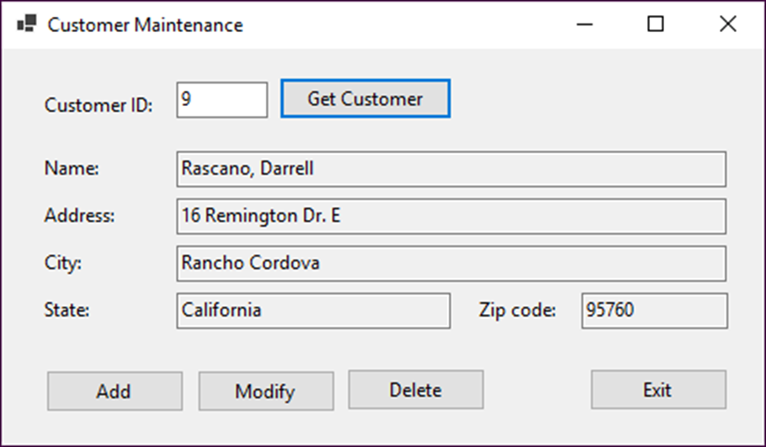
The Customer Maintenance form

Slide 50
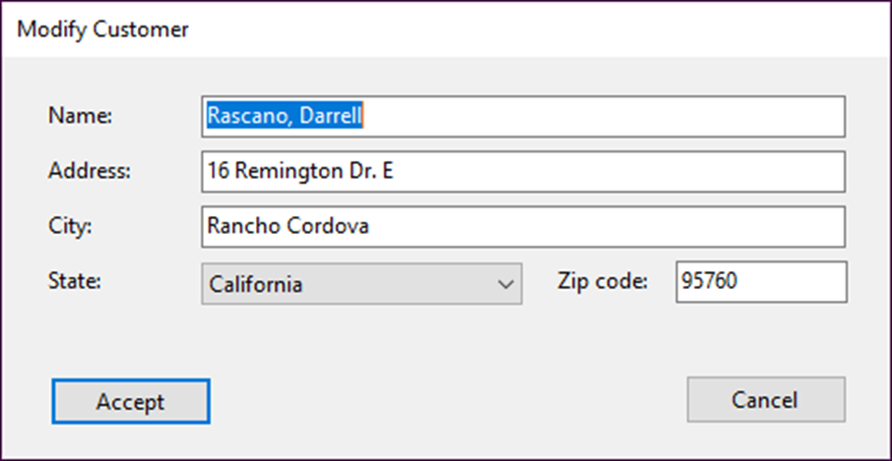
The Add/Modify Customer form

Slide 51
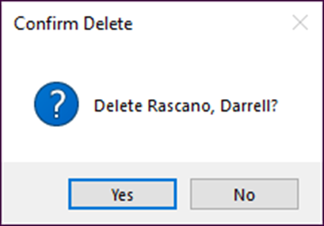
The dialog box for confirming a delete operation

Slide 52
Code for the Customer Maintenance form (part 1)
public partial class frmCustomerMaintenance : Form
{
// default constructor
private MMABooksContext context = new MMABooksContext();
private Customers selectedCustomer;
private void btnGetCustomer_Click(object sender, EventArgs e)
{
if (IsValidData())
{
int customerID = Convert.ToInt32(txtCustomerID.Text);
try
{
selectedCustomer =
context.Customers.Find(customerID);
if (selectedCustomer == null)
{
MessageBox.Show(
"No customer found with this ID. " +
"Please try again.", "Customer Not Found");
this.ClearControls();
}

Slide 53
Code for the Customer Maintenance form (part 2)
else
{
if (!context.Entry(selectedCustomer)
.Reference("StateNavigation").IsLoaded)
{
context.Entry(selectedCustomer)
.Reference("StateNavigation").Load();
}
this.DisplayCustomer();
}
}
catch (Exception ex)
{
this.HandleGeneralError(ex);
}
}
}
private bool IsValidData()
{
bool success = true;
string errorMessage = "";
errorMessage = Validator.IsInt32(txtCustomerID.Text,
txtCustomerID.Tag.ToString());

Slide 54
Code for the Customer Maintenance form (part 3)
if (errorMessage != "")
{
success = false;
MessageBox.Show(errorMessage, "Entry Error");
txtCustomerID.Focus();
}
return success;
}
private void DisplayCustomer()
{
txtCustomerID.Text = selectedCustomer.CustomerId.ToString();
txtName.Text = selectedCustomer.Name;
txtAddress.Text = selectedCustomer.Address;
txtCity.Text = selectedCustomer.City;
txtState.Text = selectedCustomer.StateNavigation.StateName;
txtZipCode.Text = selectedCustomer.ZipCode;
btnModify.Enabled = true;
btnDelete.Enabled = true;
}

Slide 55
Code for the Customer Maintenance form (part 4)
private void ClearControls()
{
txtCustomerID.Text = "";
txtName.Text = "";
txtAddress.Text = "";
txtCity.Text = "";
txtState.Text = "";
txtZipCode.Text = "";
btnModify.Enabled = false;
btnDelete.Enabled = false;
txtCustomerID.Focus();
}
private void btnAdd_Click(object sender, EventArgs e)
{
var addModifyForm = new frmAddModifyCustomer {
AddCustomer = true,
States = context.States.OrderBy(
s => s.StateName).ToList()
};
DialogResult result = addModifyForm.ShowDialog();

Slide 56
Code for the Customer Maintenance form (part 5)
if (result == DialogResult.OK)
{
selectedCustomer = addModifyForm.Customer;
try
{
context.Customers.Add(selectedCustomer);
context.SaveChanges();
this.DisplayCustomer();
}
catch (DbUpdateException ex)
{
this.HandleDataError(ex);
}
catch (Exception ex)
{
this.HandleGeneralError(ex);
}
}
}

Slide 57
Code for the Customer Maintenance form (part 6)
private void btnModify_Click(object sender, EventArgs e)
{
var addModifyForm = new frmAddModifyCustomer {
AddCustomer = false,
Customer = selectedCustomer,
States = context.States.OrderBy(
s => s.StateName).ToList()
};
DialogResult result = addModifyForm.ShowDialog();
if (result == DialogResult.OK)
{
selectedCustomer = addModifyForm.Customer;
try
{
context.SaveChanges();
DisplayCustomer();
}
catch (DbUpdateConcurrencyException ex)
{
this.HandleConcurrencyError(ex);
}

Slide 58
Code for the Customer Maintenance form (part 7)
catch (DbUpdateException ex)
{
this.HandleDataError(ex);
}
catch (Exception ex)
{
this.HandleGeneralError(ex);
}
}
}
private void btnDelete_Click(object sender, EventArgs e)
{
DialogResult result =
MessageBox.Show(
$"Delete {selectedCustomer.Name}?",
"Confirm Delete", MessageBoxButtons.YesNo,
MessageBoxIcon.Question);

Slide 59
Code for the Customer Maintenance form (part 8)
if (result == DialogResult.Yes) {
try
{
context.Customers.Remove(selectedCustomer);
context.SaveChanges();
this.ClearControls();
}
catch (DbUpdateConcurrencyException ex)
{
this.HandleConcurrencyError(ex);
}
catch (DbUpdateException ex)
{
this.HandleDataError(ex);
}
catch (Exception ex)
{
this.HandleGeneralError(ex);
}
}
}

Slide 60
Code for the Customer Maintenance form (part 9)
private void HandleConcurrencyError(
DbUpdateConcurrencyException ex)
{
ex.Entries.Single().Reload();
var state = context.Entry(selectedCustomer).State;
if (state == EntityState.Detached)
{
MessageBox.Show(
"Another user has deleted that customer.",
"Concurrency Error");
this.ClearControls();
}
else
{
string message =
"Another user has updated that customer.\n" +
"The current database values will be displayed.";
MessageBox.Show(message, "Concurrency Error");
this.DisplayCustomer();
}
}

Slide 61
Code for the Customer Maintenance form (part 10)
private void HandleDataError(DbUpdateException ex)
{
string errorMessage = "";
var sqlException = (SqlException)ex.InnerException;
foreach (SqlError error in sqlException.Errors)
{
errorMessage += "ERROR CODE: " + error.Number + " " +
error.Message + "\n";
}
MessageBox.Show(errorMessage);
}
private void HandleGeneralError(Exception ex)
{
MessageBox.Show(ex.Message, ex.GetType().ToString());
}
private void btnExit_Click(object sender, EventArgs e)
{
this.Close();
}
}

Slide 62
Code for the Add/Modify Customer form (part 1)
public partial class frmAddModifyCustomer : Form
{
// default constructor
public Customers Customer { get; set; }
public List<States> States { get; set; }
public bool AddCustomer { get; set; }
private void frmAddModifyCustomer_Load(object sender, EventArgs e)
{
this.LoadStatesComboBox();
if (this.AddCustomer)
{
this.Text = "Add Customer";
cboStates.SelectedIndex = -1;
}
else
{
this.Text = "Modify Customer";
this.DisplayCustomerData();
}
}

Slide 63
Code for the Add/Modify Customer form (part 2)
private void LoadStatesComboBox()
{
try
{
cboStates.DataSource = this.States;
cboStates.DisplayMember = "StateName";
cboStates.ValueMember = "StateCode";
}
catch (Exception ex)
{
MessageBox.Show(ex.Message, ex.GetType().ToString());
}
}
private void DisplayCustomerData()
{
txtName.Text = Customer.Name;
txtAddress.Text = Customer.Address;
txtCity.Text = Customer.City;
cboStates.SelectedValue = Customer.State;
txtZipCode.Text = Customer.ZipCode;
}

Slide 64
Code for the Add/Modify Customer form (part 3)
private void btnAccept_Click(object sender, EventArgs e)
{
if (this.IsValidData()) {
if (this.AddCustomer){
this.Customer = new Customers();
}
this.LoadCustomerData();
this.DialogResult = DialogResult.OK;
}
}
private bool IsValidData()
{
string errorMessage = "";
errorMessage += Validator.IsPresent(txtName.Text,
txtName.Tag.ToString());
errorMessage += Validator.IsPresent(txtAddress.Text,
txtAddress.Tag.ToString());
errorMessage += Validator.IsPresent(txtCity.Text,
txtCity.Tag.ToString());
errorMessage += Validator.IsPresent(cboStates.Text,
cboStates.Tag.ToString());
errorMessage += Validator.IsPresent(txtZipCode.Text,
txtZipCode.Tag.ToString());

Slide 65
Code for the Add/Modify Customer form (part 4)
bool success = true;
if (errorMessage != "")
{
MessageBox.Show(errorMessage, "Entry Error");
success = false;
}
return success;
}
private void LoadCustomerData()
{
Customer.Name = txtName.Text;
Customer.Address = txtAddress.Text;
Customer.City = txtCity.Text;
Customer.State = cboStates.SelectedValue.ToString();
Customer.ZipCode = txtZipCode.Text;
}
private void btnCancel_Click(object sender, EventArgs e)
{
this.Close();
}
}

Slide 66
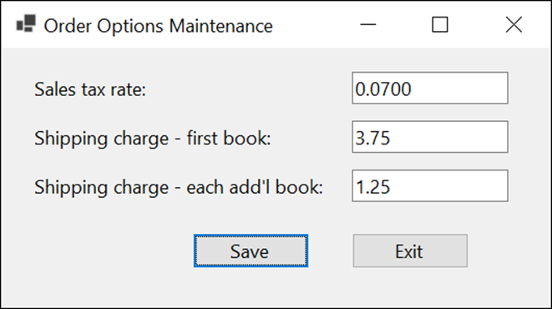
Extra 20-1 Use Entity Framework Core
Use Entity Framework Core to develop an application that lets you update the data in a table of order options.

Slide 67
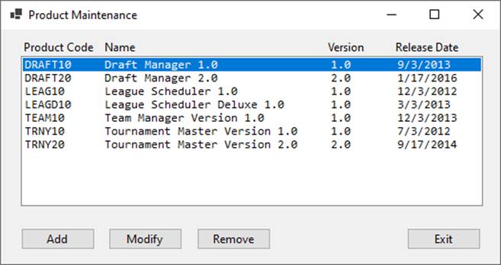
Project 5-1 Maintain products (part 1)
Use Entity Framework Core to develop an application that lets the user add, modify, and remove rows in a table of products.

Slide 68
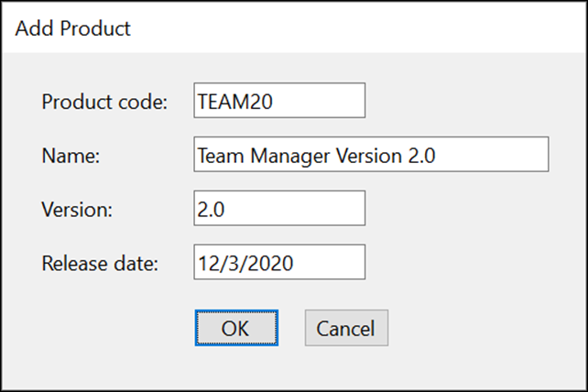
Project 5-1 Maintain products (part 2)
Develop a form that lets the user add or modify a product.

Slide 69
Objectives (part 1)
Applied
Create an Entity Data Model from an existing database.
Use LINQ to Entities to retrieve data from one or more database tables.
Use EF Core to add, modify, and delete rows in a database table.
Bind controls to an entity collection or the results of a query.
Knowledge
Explain how EF Core works.
Describe these terms as they relate to an Entity Data Model: conceptual model, storage model, mappings, object context, entity class, navigation property, and association.
Describe how to add EF packages to a project.

